Slide 1
Understanding the Drivers of Length of Stay
Jake Kealey on behalf of North Central London ICB - #6010
24/06/2025

Slide 2
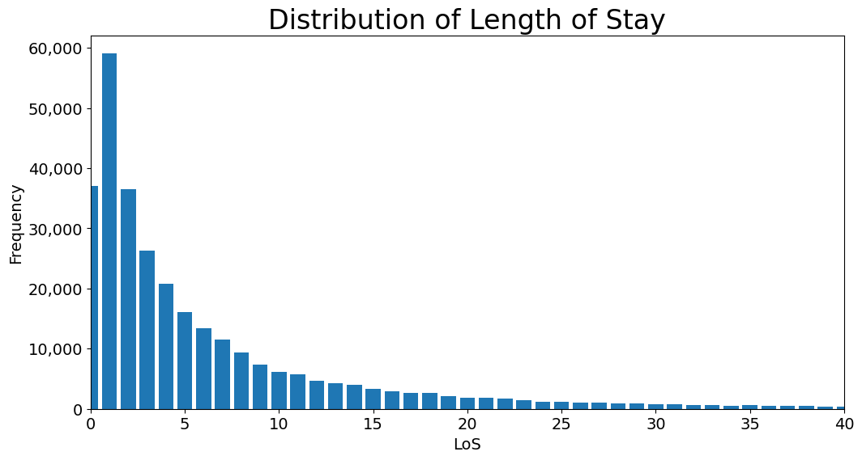
Context and Motivation
Project: Create a machine learning model to understand how Length of Stay (LoS) correlates with different features and what insights can be discovered.
How can such insights be used to influence strategy and decision making?
Notes:
Length of Stay (LoS) is defined as the number of overnight days a patient spends in a hospital bed.

Slide 3
Lessons Learnt from Existing Research Literature
Key takeaways:
Modelling LoS is notoriously complex and difficult.
Commonly used features include:
  Age, Gender, Previous Admissions, Primary Diagnosis, Comorbidity, Martial Status, Admission Type
LoS is typically modelled using a Negative Binomial or Poisson regression model.
Papers (available online):
Comparison of Regression Methods for Modelling Intensive Care Length of Stay
A systematic review of the prediction of hospital length of stay: Towards a unified framework

Slide 4
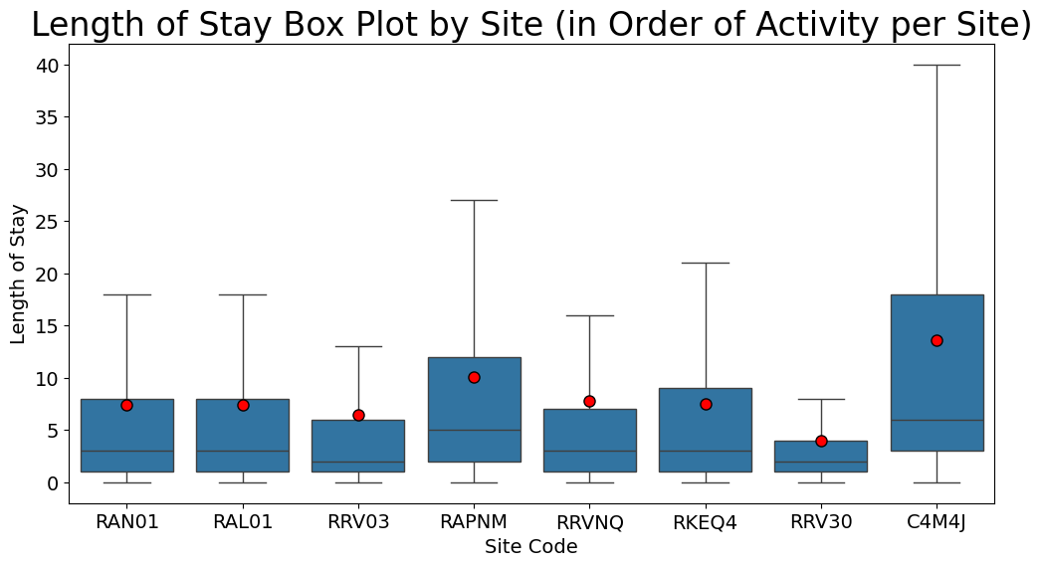
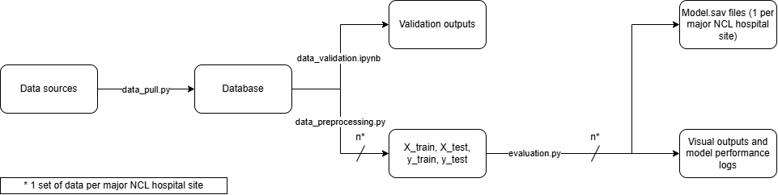
The Python Pipeline and Design
Model Design
Features: Age, Gender, Emergency Admission
1 model per “Major” hospital site
Poisson Regression and Random Forest Regressor were tested
Future Improvements:
Additional Features: Previous Admissions, Comorbidity, Primary Diagnosis
Notes:
Obstacles:
Commissioning data is difficult to work with (data quality in reporting).
Effort spent on pulling and validating data.
Justification for 1 model per site.
Iterative design.

Slide 5
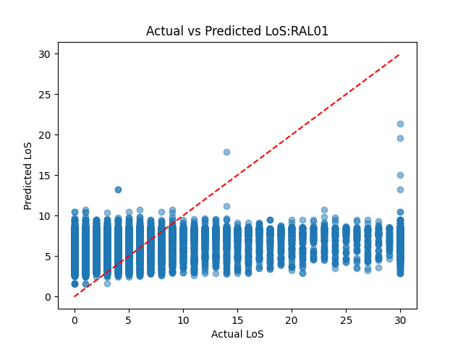
Model Performance and Predictions
Site | Root Mean Squared Error
RAL01 | 7.6
RAN01 | 7.5
RAPNM | 8.6
RKEQ4 | 7.9
RRV03 | 7.3
RRV30 | 4.7
C4M4J | 10.2
RRVNQ | 7.3

Slide 6
Key Reflections and Next Steps
Key Reflections:
Length of Stay is an incredibly complex concept to model
The Python pipeline built is robust and capable of being iterated and improved on
Details on the diagnosis and activity is required for more accurate modelling
Next Steps:
Onboarding the existing Git repo to former colleagues to carry on the work
Introduce more advanced features to improve the model

